Slide 1
Trialhorse

Slide 2
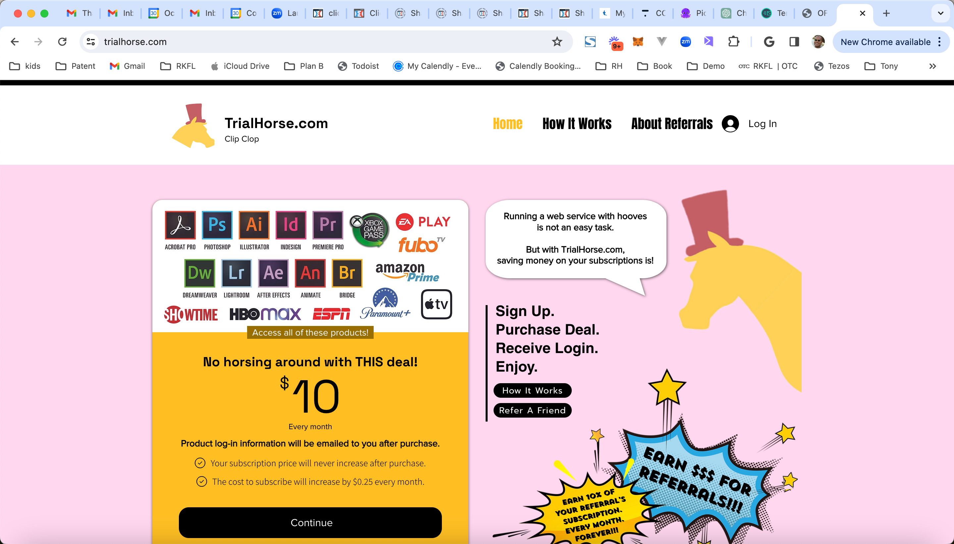
Landing Page

Slide 3
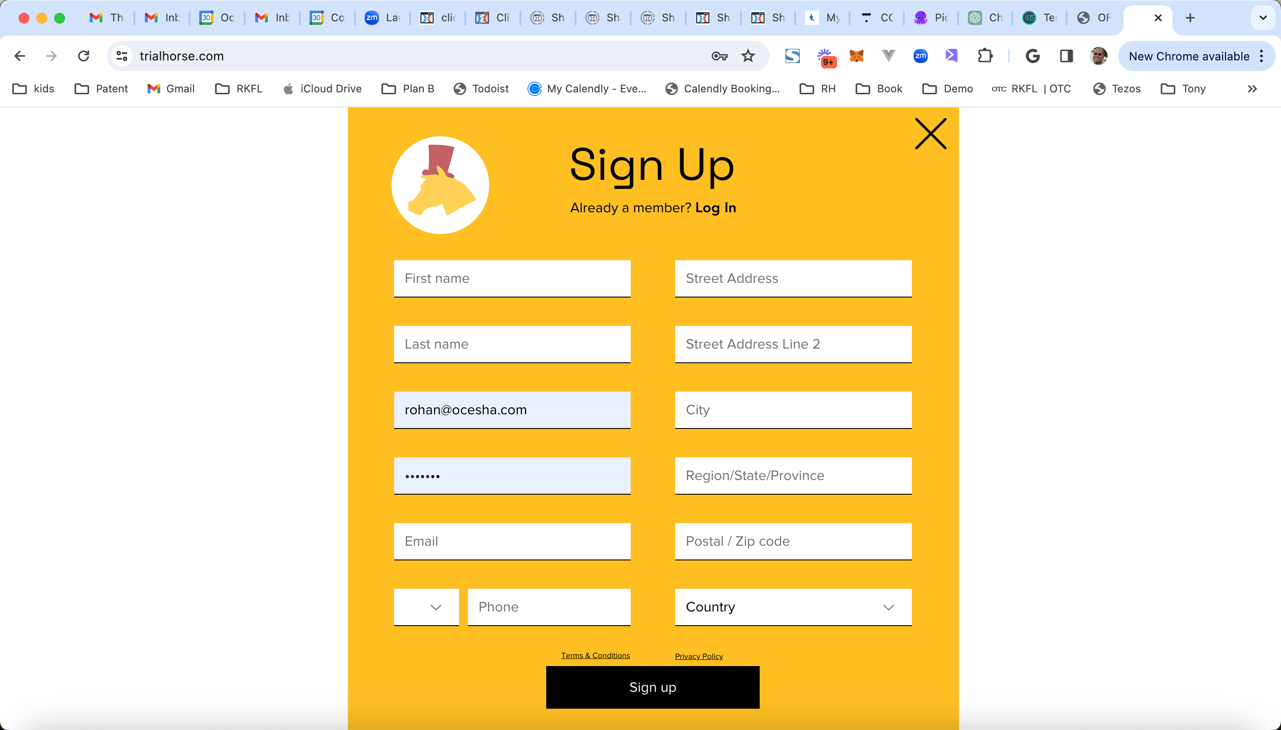
Sign Up Page

Slide 4
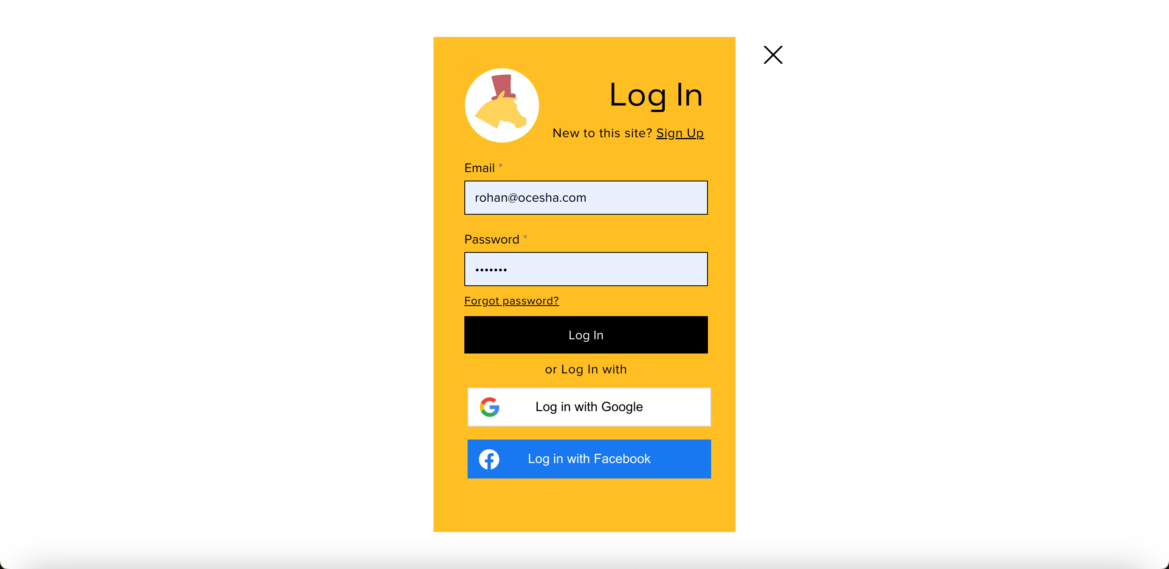
Login Page

Slide 5

Internal Page
Generate affiliate code
Trailhorse.com?affiliate=rohanhall
Goes to Payment Page

Slide 6
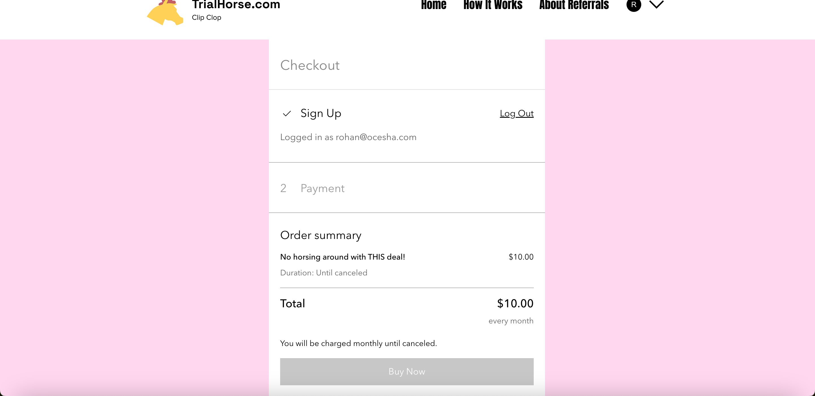
Payment Page
Pay with Wix ecommerce
NEED TO CONFIGURE
1. Collect payment from user $10/month with Wix payment system. Increase payment by 25 cents each month

Slide 7
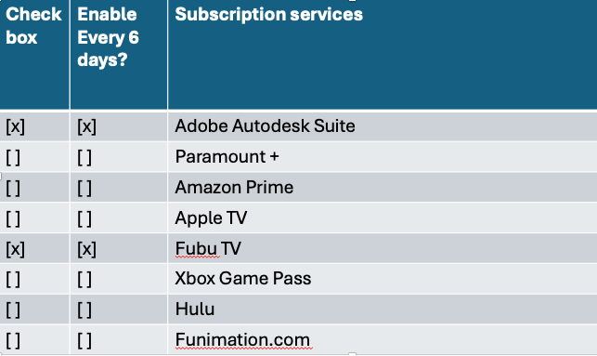
Subscription Selection Page
NEED TO CREATE FORM
User can click the boxes
Store this data for each user.
Update if user change the value
Expose API READ access for external dev to get this data plus user basic data including email address, name, payment amount, payment date

